Slide 1
Chapter 4 Linked Lists
Notes:
第四章 链表

Slide 2
4.0 Pointers
Pointer Operators
  & ：the address operator
  * ：the deferencing ( or indirection ) operator
  Example
    int i, *pi ;
    pi = & i; i = 10; *pi = 10;
Other operations:
  assign a pointer to a variable of type pointer
  arithmetic operations ( + - * / ) on a pointer
Notes:
预备知识：指针
指针的操作：
&: 取地址
*：引用
其他操作：
指针赋值
指针的算术操作

Slide 3
wise programming
1) set all pointers to NULL when they are not actually pointing to an object.
  the null pointer is represented by the integer 0
2) define explicit return type for function
3) using dynamically allocated storage (malloc, free)
malloc,free的函数原型为：
void * malloc(unsigned size);
void free(void *p);
int i, *pi;
float f, *pf;
pi = (int *) malloc(sizeof(int));
pf = (float *) malloc(sizeof(float));
*pi = 1024;
*pf = 3.14;
printf ("an integer = %d, a float = %f \n", *pi, *pf );
free(pi);
free(pf);
Notes:
聪明的编程方法：
对于没有指向有效对象的指针，一律将其置为NULL
2. 对于函数，尽可能显式返回数据
3. 使用动态内存分配

Slide 4
Array and Linked List
Array
Linked List

Locations of elements
can be easily computed
Elements may be placed
anywhere in memory

Moving elements in an
ordered list can be
expensive
Finding an element may
be expensive
Review the relevant materials in C
if you don’t know what I am talking about.
Notes:
数组和链表的优缺点
数组：优点：随机访问数据；缺点：在有序数组里移动数据需要大量时间
链表：优点：数据可以存储在内存的任何位置；缺点：查找某个元素非常麻烦

Slide 5
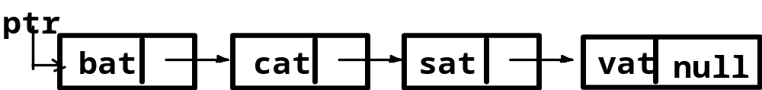
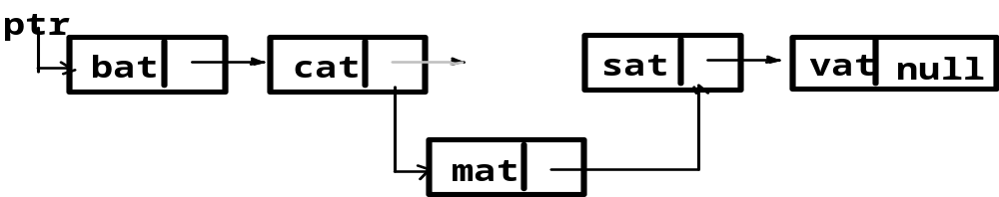
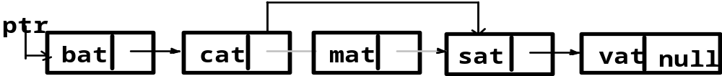
4.1 Singly Linked Lists
Linked list
  an ordered sequence of nodes with links represented as arrows
  Insert mat after cat :
  Delete mat from list :
Notes:
4.1. 单向链表
链表：
一个有序的包含指针的节点序列
插入元素
删除元素

Slide 6
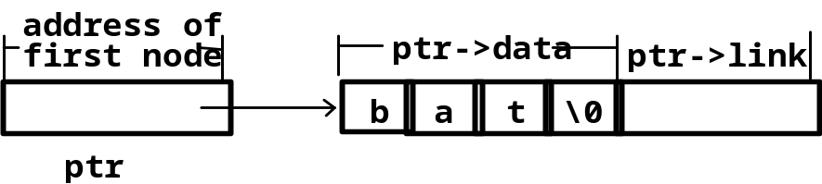
4.2 Representing Chains in C
Define a node's structure ---- self-referential structures
Create a new node ---- malloc function
Remove nodes ---- free function
〖example〗list of words ending in at
define a node typedef struct listNode *listPointer;
structure typedef struct listNode {
char data [ 4 ];
listPointer link;
};
create a new list listPointer ptr = NULL;
( #define IS_EMPTY(ptr) ( ! ( ptr )) )
create new nodes ptr = (listPointer) malloc ( sizeof (listNode ));
place a word into the list strcpy ( ptr ->data, "bat");
ptr -> link = null;
Free point free(ptr);
Notes:
链表的C语言表达

Slide 7
〖example〗List insertion
x
first
...
...
a₁
a_{i}
a_{i+1}
a_{n}
NULL
① temp->link =
x-> link
② x-> link = temp
b
temp
Question: What will happen
if the order of the two steps is reversed?
Notes:
插入操作
注意：顺序不可以颠倒

Slide 8
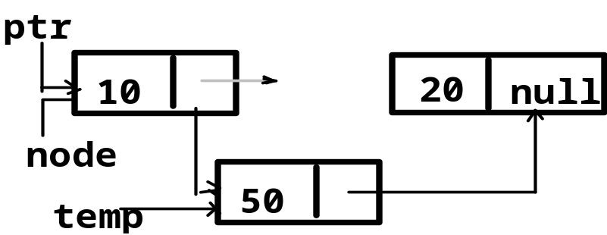
〖example〗List insertion
#define IS_FULL (ptr ) ( ! (ptr ))
void insert(listPointer *first, listPointer x)
{ /* insert a new node with data = 50 into the list ptr after node */
list_pointer temp;
temp = (listPointer)malloc(sizeof(listNode));
if ( IS_FULL(temp) ) {
fprintf(stderr, "The memory is full\n');
exit(1);
}
temp->data = 50;
if ( *first) {
temp->link = x->link;
x->link = temp;
}
else {
temp->link = NULL;
*first= temp;
}
}
Notes:
链表插入操作代码

Slide 9
〖example〗list deletion
trail
first
...
...
a₁
a_{i}
a_{i+1}
a_{n}
NULL
① trail-> link =
x-> link
② free ( node )
b
b
node
x
Question: How can we
delete the first node from a list?
Notes:
链表删除操作

Slide 10
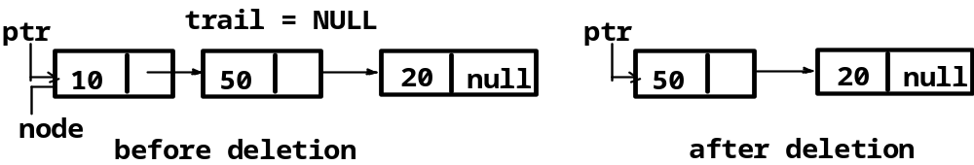
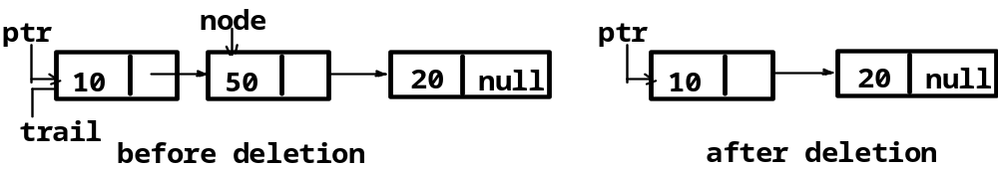
〖example〗list deletion
void delete(listPointer *first, listPointer trail, listPointer x)
{ /* delete node from the list, trail is the preceding node ptr is the head of the list */
if ( trail )
trail->link = x->link;
else
*first= (*first)->link;
free(x);
}
List after the function call delete(&ptr, NULL, ptr)
List after the function call delete(&ptr, ptr, prt->link)
Notes:
链表节点的删除
同样要注意顺序

Slide 11
〖example〗Printing out a list
void print_list(listPointer first)
{
printf("The list contains: ");
for ( ; first; first= first->link )
printf("%4d”,first->data);
printf("\n");
}
Notes:
打印链表（链表的遍历）

Slide 12


4.3 Linked Stacks and Queues
Linked Stacks
STACK
 Push:
① temp->link = top
② top = temp
temp
 Pop:
① temp = top
item
top
② top = top->link
•
③ item = temp->item
item
top
item
top
④ free ( temp )
•
⑤ return item
Question:
How to represent n stacks?
item
•
Answer:
stackPointer top [ n ] ;
item
NULL
Notes:
用链表实现栈
栈顶放在链表的头部

Slide 13
Program : Add to a linked stack
#define MAX_STACKS 10 /*maximum number od stacks */
typedef struct {
int key ；
/* other fields */
} element;
typedef struct stack *stackPointer;
typedef struct stack {
element item;
stackPointer link；
};
stackPointer top [ MAX_STACKS ];
void push(stackPointer *top, element item)
{
/* add an element to the top of the stack */
stackPointer temp = (stack_pointer)malloc(sizeof(stack));
if ( IS_FULL(temp) ) {
fprintf( stderr, "The memory is full\n");
exit(1);
}
temp->item = item;
temp->link = *top;
*top = temp;
}
Notes:
链表栈的Push操作

Slide 14
Program : Delete from a linked stack
element pop(stackPointer *top)
{
/* delete an element from the stack */
stackPointer temp = *top;
element item;
if ( IS_EMPTY(temp) ) {
fprintf(stderr, "The stack is empty\n");
exit(1);
}
item = temp->item;
*top = temp->link;
free(temp);
return item;
}
the boudary condition for the stacks:
  top [ i ] = NULL, iff the i th stack is empty 0 <= i < MAX_STACKS
  IS_FULL ( temp) iff the memory is full
Notes:
链表栈的pop操作

Slide 15
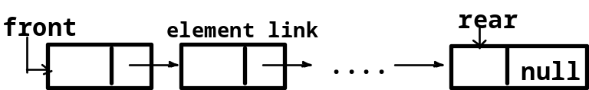
Linked Queues
QUEUE
 addq:
① rear->next = temp
•
NULL
temp
item
rear
② temp->next = NULL
③ rear = temp
•
NULL
 deleteq:
① temp = front
item
rear
② front = temp->next
item
•
③ item = temp->item
item
front
④ free ( temp )
⑤ return item
•
temp
item
front
Question:
How to represent n queues?
Answer:
queuePointer front[n], rear[n];
Notes:
链表队列
需要维护两个指针，分别指向队列的头和尾

Slide 16
Program: Add to the rear of a linked queue
#define MAX_QUEUES 10 /*maximum number of queues */
typedef struct queue *queuePointer;
typedef struct queue {
element item;
queuePointer link:
};
queuePointer front [MAX_QUEUES], rear [MAX_QUEUES ];
void addq(queuePointer *front, queuePointer *rear, element item)
{ /* add an element to the rear of the queue */
queuePointer temp = (queuePointer)malloc(sizeof(queue));
if ( IS_FULL(temp) ) {
fprintf(stderr, "The memory is full\n");
exit(1);
}
temp->item = item;
temp->link = NULL;
if ( *front ) (*rear)->link = temp;
else *front = temp;
*rear = temp;
}
Notes:
链表队列中的加入元素

Slide 17
Program: Delete from the front of a linked queue
element deleteq(queuePointer *front)
{
/* delete an element from the queue */
queuePointer temp = *front;
element item;
if ( IS_EMPTY(*front) ) {
fprintf(stderr, "The queue is empty\n");
exit(1);
}
item = temp->item;
*front = temp->link;
free(temp);
return item;
}
the boudary condition for the queues:
  front [ i ] = NULL, iff the i th queue is empty 0 <= i < MAX_QUEUES
  IS_FULL ( temp) iff the memory is full
Notes:
链表队列中删除元素

Slide 18
4.5 Additional List Operations
1. operations for chains
  a) Inverting a singly linked list
  b) Concatenating singly linked lists
2. operations for circularly linked lists
  a) Inserting at the front of a list
  b) Finding the length of a circular list
Notes:
其他链表操作
链表的反向
循环链表的应用

Slide 19
a) Inverting a singly linked list
listPointer invert (listPointer lead )
{ /* invert the list pointed to by lead */
listPointer middle, trail ;
middle = NULL ; trail=NULL;
/* middle is head of the inverted chain */
while ( lead ) {
middle = lead ;
lead = lead->link;
middle->link= trail ;
trail = middle ;
} /* end while-loop */
return middle ;
}
middle
lead
middle
middle
lead
lead
trail
NULL
1
2
1
2
3
•
•
•
•
•
2
trail
1
NULL
3
NULL
•
•
•
3
trail
NULL
NULL
•
T_{invert} = O( length of lead )
NULL
Notes:
链表的反转，使用三个指针实现

Slide 20
b) Concatenating singly linked lists
listPointer concatenate listPointer ptr1, listPointer ptr2)
{
/* produce a new list hat contains the list ptr1 followed by the list ptr2. The list pointed to by ptr1 is changed permanently */
listPointer temp;
if ( IS_EMPTY(ptr1) ) return ptr2;
else {
if ( !IS_EMPTY(ptr2) ) {
for ( temp = ptr1; temp->link; temp = temp->link )
;
temp->link = ptr2;
}
return ptr1;
}
}
T_{concatenate} = O( length of ptr1 )
Notes:
两个链表的连接

Slide 21
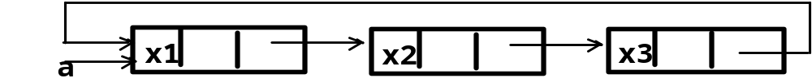
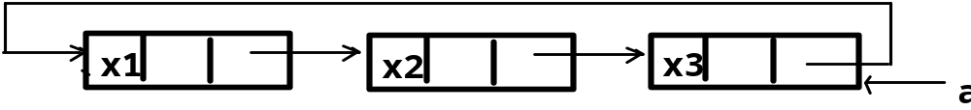
a) Inserting at the front of a circularly linked list
void insert_front listPointer *last, listPointer node)
/* insert node at the front of the circular list last, where last is the last node in the list */
{ if ( IS_EMPTY(*last) ) {
/* list is empty, change ptr to point to new entry */
*last= node;
node->link = node;
}
else { /* list is not empty, add new entry at front */
node->link = (*last)->link;
(*last)->link = node;
}
}
Notes:
循环队列的头部插入元素

Slide 22
b) Finding the length of a circular list
int length(listPointer last)
{ /* find the length of the circular list last */
list_pointer temp;
int count = 0;
if (last) {
temp = last;
do {
count ++;
temp = temp->link;
} while ( temp != last);
}
return count;
}
Notes:
循环队列长度

Slide 23
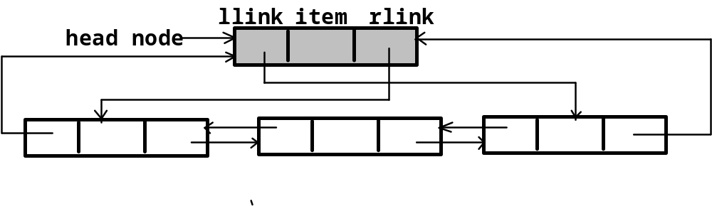

4.8 Doubly Linked lists
typedef struct node *nodePointer;
typedef struct node {
nodePointer llink;
element item;
nodePointer rlink;
};
ptr = ptr -> llink -> rlink = ptr -> rlink -> llink
empty list
Notes:
双向链表
优点：可以很容易的找到前一个节点

Slide 24
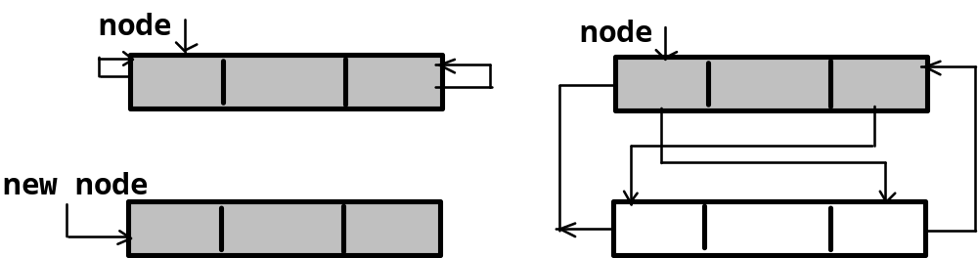
Program : Insertion into a doubly linked circular list
void dinsert(nodePointer node, nodePointer newnode)
{ /* insert newnode to the right of node */
newnode->llink = node;
newnode->rlink = node->rlink;
node->rlink->llink = newnode;
node->rlink = newnode;
}
Notes:
在双向链表中插入新节点

Slide 25
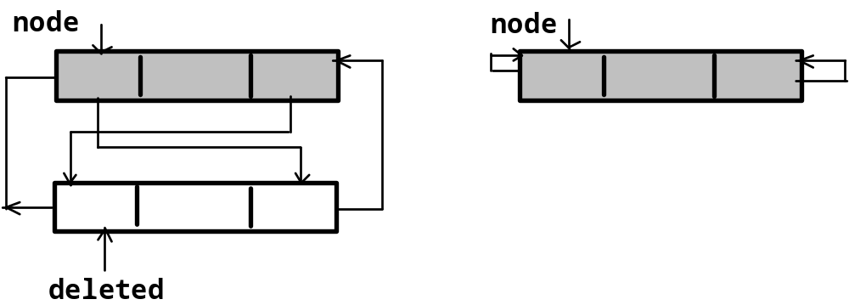
Program: Deletion from a doubly linked circular list
void ddelete(nodePointer node, nodePointer deleted)
{ /* delete from the doubly linked list */
if ( node == deleted )
printf("Deletion of head node not permitted.\n");
else {
deleted->llink->rlink = deleted->rlink;
deleted->rlink->llink = deleted->llink;
free(deleted);
}
}
Notes:
在双向循环链表中删除节点

Slide 26
Homework
Page 154 2, 3
Page 160 2
Page 174 4

